Slide 1
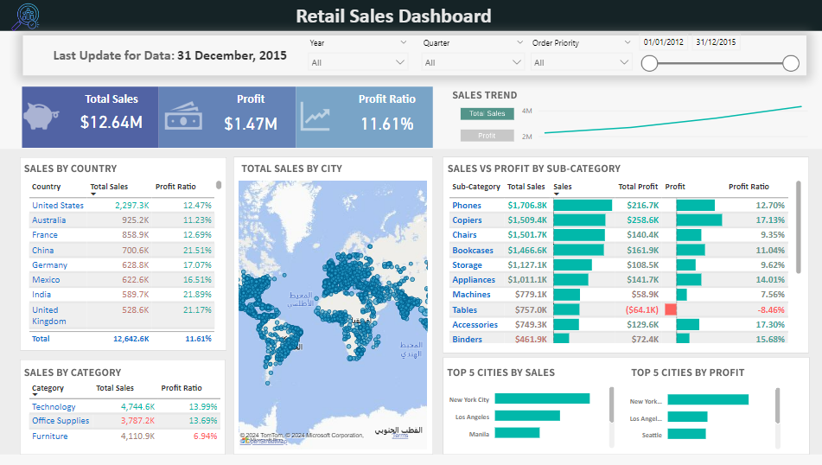
Retail Sales Performance Report
Key Insights and Trends (2012-2015)

Slide 2




Global Electronics Retailer Performance Analysis (2012-2015)
Sales Performance Analysis
Product Returns Evaluation
Global Electronics Inc. analyzed sales data from 2012-2015 to identify overall trends, top-selling products, and profitability drivers.
Return rates in the Global market were assessed to improve customer satisfaction and reduce costs.
Customer Segmentation
Data-Driven Decision Making
The company segmented customers based on demographics, location, and purchase behavior to tailor marketing strategies.
Insights from the Power BI dashboard enabled informed decisions on inventory management, marketing campaigns, and cost optimization.
The retail sales analysis provided a comprehensive understanding of Global Electronics Inc.'s performance, enabling data-driven strategies for growth and profitability.

Slide 3
Retail Sales Dataset Overview
Fact Table: Orders
Dimension Tables
Captures transactional data like Order ID, Order Date, Product ID, Customer ID, Quantity, Sales, Discount, and Profit. Primary source for sales metrics.
Date Table: Enables temporal analysis of sales patterns and trends. People Table: Facilitates customer segmentation and purchasing behavior analysis. Product Table: Allows product-level analysis of sales, popularity, and profitability. Returns Table: Tracks returned orders for return rate analysis.
Relationships
Analysis Potential
One-to-many relationships between Orders and dimension tables (Date, People, Product). Many-to-one relationship between Orders and Returns.
Sales trends, product performance, customer behavior, return analysis, regional/market insights. Comprehensive retail sales analysis for data-driven decision making.

Slide 4
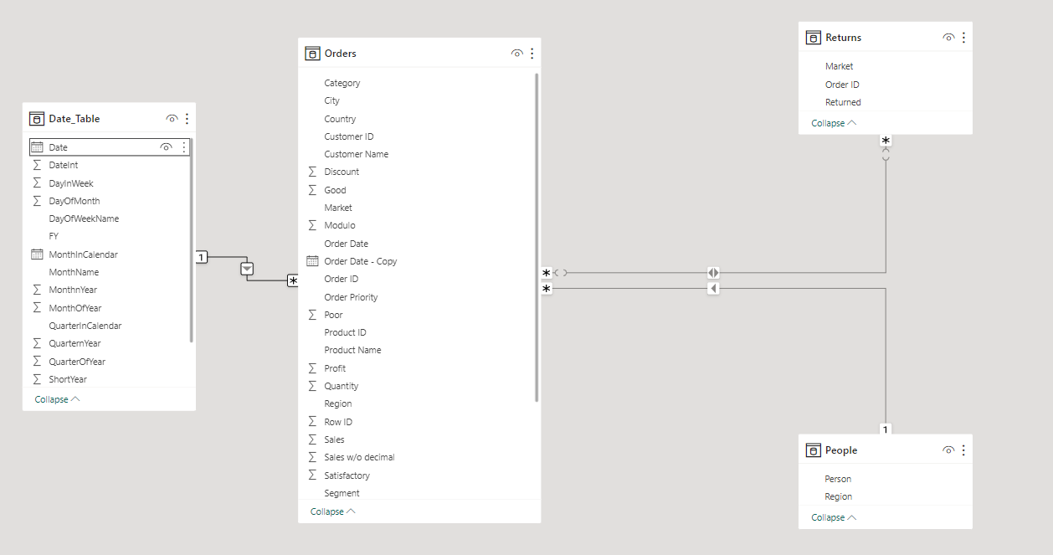
Data Modeling
Data modeling is the process of creating a visual representation of an information system, depicting entities, attributes, and their relationships. It provides a blueprint for designing and implementing databases and serves as a communication tool for stakeholders.

Slide 5




Overview: Retail Sales Analysis Dashboard
Introduction to Key Metrics
Sales Trends and Patterns
Regional Performance Analysis
Product Category Breakdown
Provide an overview of the critical performance indicators for retail sales analysis.
Highlight the observed trends and patterns in sales data over different time periods.
Compare sales performance across different regions or geographical areas.
Analyze sales by product categories to identify top-selling and underperforming categories.
This overview slide provides a high-level summary of the key aspects covered in the Retail Sales Analysis Dashboard, setting the context for a deeper dive into the data.

Slide 6
Executive Summary
Total Sales
Profit
Sales Trend
$12.64M
$1.47M (11.61% Profit Ratio)
Steady growth over 4 years with quarterly fluctuations
Top Countries
Top Cities
Top Product Categories
United States, Australia, France
New York City, Los Angeles (dominate sales and profits)
Technology products (majority sales), Office supplies (highest profit ratio)

Slide 7


Sales Performance by Country
Country
Total Sales ($K)
Profit Ratio (%)
United States
2297.3
12.47
Australia
925.2
11.23
France
858.9
12.69
China
700.6
21.51
Germany
628.8
17.07
Mexico
622.2
16.51
India
589.7
21.89
United Kingdom
528.6
21.17

Slide 8
Key Insights
Top Performers
High-Growth Markets
The United States leads in total sales (2,297.3K), followed by Australia (925.2K) and France (858.9K).
Emerging markets like China (sales: 700.6K, profit ratio: 21.51%) and India (sales: 589.7K, profit ratio: 21.89%) demonstrate strong sales and high-profit ratios, indicating significant growth potential.
Profitability Variations
Strategic Adaptation
Profit ratios vary across countries, with the Philippines and Turkey facing negative ratios, while El Salvador boasts the highest at 23.67%, highlighting the importance of understanding regional market dynamics.
Adjusting strategies according to regional market dynamics is crucial to optimize performance and profitability.

Slide 9
Strategic Recommendations: Sales Performance by Country
Expand in High-Growth Markets
Analyze Underperformance
Allocate resources to increase operations and marketing efforts in rapidly growing markets like China and India, capitalizing on their vast potential for future growth and profitability.
Conduct in-depth analysis of factors contributing to negative profit ratios in the Philippines and Turkey, identifying areas for improvement or potential market withdrawal.
Optimize Regional Strategies
Foster Market Agility
Develop tailored strategies for each market, including localized product offerings, pricing models, and marketing campaigns to cater to regional preferences and maximize sales and profitability.
Implement agile processes to rapidly adapt to changing market dynamics, consumer trends, and competitive landscapes, ensuring sustained growth and competitiveness across regions.

Slide 10


Sales and Profitability by Category
Category
Total Sales (K)
Profit Ratio (%)
Technology Products
4744.6
13.99
Office Supplies
3787.2
13.69
Furniture
4110.9
6.94

Slide 11
Retail Sales Analysis Interpretation
Technology Leading Sales
Office Supplies Close Behind
Dominates total sales with $4,744.6K, showcasing strong demand for electronics and related products.
Achieved $3,787.2K in sales, indicating steady demand for business essentials.
Higher Profitability in Office Supplies
Furniture Category Underperforming
Despite lower total sales, Office Supplies maintained a higher profit ratio of 13.99% compared to Technology at 13.69%.
Lagging in both total sales ($4,110.9K) and profit ratio (6.94%), requires investigation into root causes and potential improvements.

Slide 12
Recommendations: Sales and Profitability by Category
Leverage Technology
Optimize Office Supplies
Capitalize on the strong demand in the Technology category by investing in product expansion, targeted marketing campaigns, and optimizing inventory management to drive overall sales growth.
Explore strategies to enhance the profitability of the Office Supplies category, such as cost reduction initiatives, strategic pricing adjustments, and targeted promotional campaigns focused on high-margin products.
Investigate Furniture Performance
Diversify Product Portfolio
Conduct a comprehensive analysis of the Furniture category to identify areas for improvement, including pricing strategies, product assortment, marketing effectiveness, and target audience alignment.
Evaluate opportunities to expand into new product categories with higher profit margins that complement the existing offerings, leveraging market research, consumer trends, and competitive analysis.

Slide 13
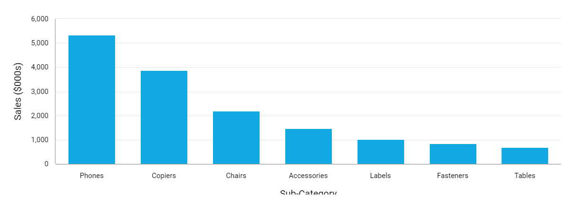
Sales and Profit by Retail Sub-Category
Copiers, accessories, and labels generate highest profits despite lower sales.

Slide 14
Key Insights
Top Sellers
Profit Leaders
Phones lead in sales, followed by copiers and chairs.
Copiers, accessories, and labels have the highest profit ratios, indicating efficient revenue conversion.
Low-Profit Category
Balancing Act
Tables stand out with negative profit, signaling a need for immediate attention.
Some sub-categories like phones have high sales but lower profit margins, while others like fasteners have lower sales but higher profit margins.

Slide 15
Recommendations: Sales and Profit by Retail Sub-Category
Focus on High-Profit Sub-Categories
Investigate Tables
Prioritize copiers, accessories, and labels to maximize profitability. Consider strategies like upselling, bundling, or targeted marketing to further boost sales.
Conduct a thorough analysis to understand the root causes of the negative profit in tables. Evaluate pricing, production costs, and market demand to identify solutions.
Optimize Phone Strategy
Evaluate Product Portfolio
While phones are top sellers, their lower profit margin indicates potential for improvement. Explore ways to increase prices, reduce costs, or promote higher-margin accessories alongside phone sales.
Regularly assess the product mix to ensure a healthy balance between high-volume, low-margin products and lower-volume, high-margin products.

Slide 16
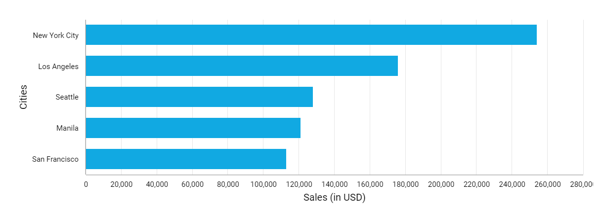
Top Cities on Sales
New York City dominates retail sales, outperforming other major cities.

Slide 17
Key Insights
New York City: Market Leader
Los Angeles: Strong Contender
New York City leads with 256K in sales, significantly outperforming other cities in the retail market.
Los Angeles holds the second position with 176K in sales, indicating a robust market presence and consumer demand.
Seattle and Manila: Competitive Players
San Francisco: Substantial but Lagging
Seattle and Manila display competitive sales figures, with Seattle slightly ahead at 128K compared to Manila's 121K.
San Francisco ranks fifth with 113K in sales, a substantial amount but notably lower than the top two cities, New York City and Los Angeles.

Slide 18
Market Recommendations for Retail Sales Growth
New York City & Los Angeles
Seattle & Manila
Investigate factors driving success and strategies to strengthen market position, such as optimizing store locations, tailoring product offerings, and enhancing customer experiences.
Analyze growth potential, opportunities (e.g., emerging consumer trends), and challenges (e.g., competition, regulations) specific to these markets to develop effective expansion strategies.
San Francisco
Geographical Expansion
Evaluate current investment levels and strategies, and consider adjustments to marketing, pricing, or product mix to boost sales performance in this market.
Explore opportunities to diversify customer base by expanding into new cities or regions, conducting market research to identify promising areas for growth.

Slide 19
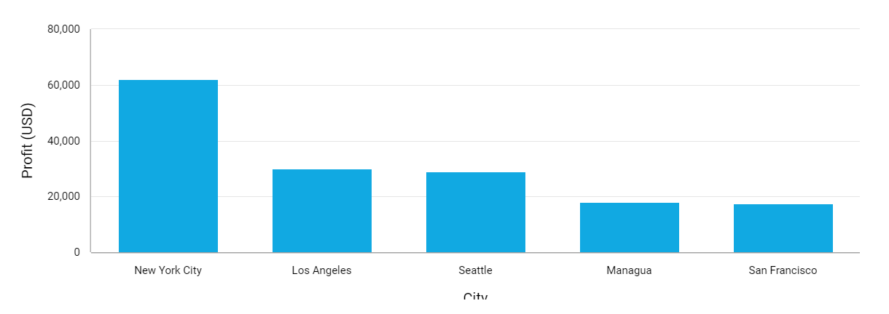
Top 5 Cities by Profit
New York City dominates profitability across these top cities.

Slide 20
Profit Insights
New York City
Los Angeles
Seattle
Dominates the chart with $42K in profit, highlighting exceptional performance and profitability in this key market.
Secures second position with $30K in profit, indicating a strong market presence and profitable operations.
Achieves a respectable $27K in profit, showcasing consistent profitability in this region.
San Francisco and Managua
Profit Concentration
Optimization Opportunity
Both cities generate $14K in profit each, contributing significantly despite being the lowest among the top 5 locations.
The chart reveals a concentration of profit in New York City, followed by a considerable gap between Los Angeles and the remaining cities.
This suggests a potential opportunity to focus on the top markets, particularly New York City and Los Angeles, for further profit optimization and growth strategies.

Slide 21
Market Recommendations for Profit Growth
New York City
Los Angeles
Investigate factors driving exceptional profitability, such as market dynamics, consumer behavior, and successful marketing strategies. Replicate proven approaches in other markets.
Analyze potential for further profit growth through market analysis, identifying untapped segments or opportunities. Implement strategies to bridge the profitability gap with New York City.
Seattle, Managua, and San Francisco
Continuous Improvement
Evaluate opportunities to enhance profitability through targeted marketing campaigns, adjusting pricing strategies, or implementing cost-saving measures tailored to each market's unique characteristics.
Regularly monitor market trends, consumer behavior, and competitor strategies to adapt and refine profitability strategies across all markets.

Slide 22

Retail Sales Analysis Interpretation: Thank You!
Expressing gratitude is a cornerstone of building strong relationships with customers. A simple 'Thank You!' can go a long way in fostering loyalty and creating a positive brand experience.

